Slide 1

DAYREV25 ENGINEERING COMPANY LIMITED SOLAR PANEL POWER BANK
By Ajayi Olaniyi

Slide 3
Problem Statement
The increasing adoption of phones (androids and ios), laptops and desktops computers among Gen Z users in Nigeria, driven by virtual classes, tutorials, conferences, and remote works is severely hindered by the unreliable and intermittent electricity supply hampering their ability to effectively manage their time , meet deadlines and maintain productivity.

Slide 4
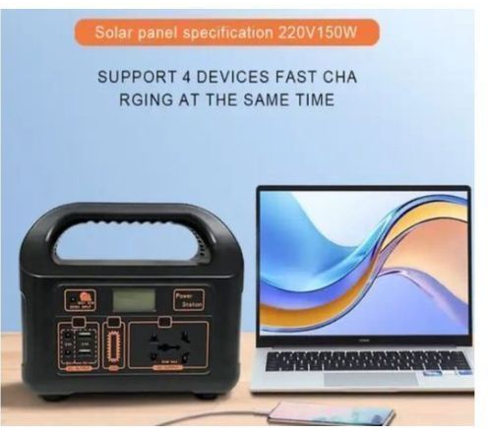
Solution
Solar-powered energy storage system (Solar Panel Power Bank) designed to provide reliable, efficient, and cost-effective electricity for over 70% laptops, desktops, and other essential devices users, enabling Gen Z , students and professionals to stay productive and connected despite grid instability.

Slide 5
Product features
Hardware components Software features Safety features
5-10W high efficiency monocrystalline Battery management system: FCC compliance
Or polycrystalline panel monitor battery state, voltage UL certification
Battery:10000-50000mAh, lithium-ion temperature and charge cycles. CE certification
Or lithium-polymer battery Power sharing: Allows multiple Battery protection
Power management system: Regulate devices to share power. Thermal protection
Solar charging ,discharge and protects Low voltage disconnect: prevent
Battery. deep discharge.
Connectivity and User Interfaces Environmental
Compatibility considerations
USB-C (PD): supports fast charging and LCD/LED display: shows battery Water-resistant and
Data transfer. Level and charging status. Dust proof design.
Micro-USB: for charging and firmware Intuition button layout: Easy Operating temp.range
Updates. navigation and control. 0-45 degree Celsius.
Bluetooth/Wi-Fi.

Slide 6
Value Proposition
Customer Benefits Investors
Reliable Power :Uninterrupted energy Growing Market Demand: Increasing
For critical devices. adoption of renewable energy solutions
Convenience : Portable and user- Competitive Advantage: Unique technology
friendly design. and business model.
Cost Savings: Reduced energy expenses. Scalability: Potential for expansion.
Environmental Sustainability :Eco-friendly Experienced Team : Proven track record.
Alternative.
Enhanced Productivity :Uninterrupted power Social Impact: contribute to sustainable
for work/study. development

Slide 7
Customers
Data Analysis: Survey distribution
Target market demographics. Social media platform
User pain points and needs. Online forums and communities.
Market demand and potential. Professional networks (Linkedin).
Competitive landscape. Local universities and organisations.
Key Characteristics:
Age: 18-40 years old (Gen Z and young professionals)
Gender: Both males and females
Income Level: Middle to upper-middle class ( $500-$5,000 monthly)
Location: Urban and suburban areas in developing countries with frequent power outages
Occupation: Students, freelancers, entrepreneurs, remote workers, and small business owners
Education: High school diploma or higher
Technology literacy: Basic to intermediate

Slide 8
MARKET
Digital Marketing Sales strategy Market Presence Growth
Website Optimization Direct Sales Community Engagement
Content Marketing E-commerce Market Research
Social Media. Sales Team Expansion into New Markets_
Influencer Marketing. Indirect Sales Thought Leadership
Email Marketing. Distribution Partnership
Paid Advertising Retail Partnership
Offline Marketing Bulk Sales Performance Metrics
Trade Shows and Events. Website Traffic
Product Demonstrations. Conversion Rates
Partnerships and Collaborations. Customer Retention
Budget Allocation
Digital Marketing (30%)_: Content creation, advertising and social media.
Offline Marketing (20%)_: Trade shows, events and partnerships.
Sales Team and Training (20%)_: Develop sales expertise.
Distribution and Retail Partnerships (15%)_: Establish and maintain relationships.
Research and Development (15%)_: Continuously improve the product.

Slide 9
Competition
Competitive Advantages
Innovative Technology*: Patented power management system for enhanced efficiency.
Strategic Partnerships*: Collaborations with key suppliers and industry experts.
Strong Research and Development*: Continuous improvement and innovation.
Experienced Management Team*: Proven track record in renewable energy and entrepreneurship.
Scalable Business Model*: Potential for expansion into new markets.
Key Differentiators
Hybrid Solar and Battery Power*: Combines advanced solar panel technology with high-capacity battery storage, ensuring uninterrupted power.
Efficient Power Management*: Optimized algorithms for maximum energy harvesting and reduced power loss.
Compact and Lightweight Design*: Enhanced portability for ease of use.
Multi-Device Support*: Simultaneous charging of multiple devices.
Advanced Safety Features*: Overcharge protection, short-circuit protection and thermal protection.
User-Friendly Interface*: Intuitive LCD/LED display and mobile app for real-time monitoring.
Durable and Water-Resistant*: Rugged design for harsh environments.
Cost-Effective*: Competitive pricing without compromising quality.
Eco-Friendly*: Sustainable energy solution reducing carbon footprint.
Local Support and Services*: Dedicated customer support and after-sales services.

Slide 10
Revenue and Model
Revenue Streams
Product Sales: Direct-to-consumer sales through online platforms, retail partnerships and strategic distributors.
Subscription Services*: Offer monthly/annual plans for premium features, priority support and replacement warranties.
Bulk Orders: Cater to businesses, organizations and government institutions requiring customized solutions.
Pricing Strategy
Base Model*: $99-$149 (5W solar panel, 5,000mAh battery)
Premium Model*: $199-$299 (10W solar panel, 20,000mAh battery)
Enterprise Solutions*: Customized pricing for bulk orders
Additional Revenue Opportunities
-Accessories (carrying cases, adapters)
Energy efficiency consulting services
Solar panel maintenance and replacement services

Slide 11
Scalability
Key Milestones:
Product Development:
Prototype completion:: 80% (functional prototype with 5W solar panel and 5,000mAh battery)
Design refinement: Ongoing (ergonomic design, waterproofing and user interface enhancements)
Customer Growth:
Target audience identification: 80% (outdoor enthusiasts, remote workers and environmentally conscious consumers)
Social media presence: 2,500 followers (Facebook, Instagram, Twitter)
Email subscribers*: 1,000+
Partnerships:
Supplier agreements: 2 (secured reliable component sourcing)
Distribution partnerships: 1 (regional distributor for West Africa)
Revenue:
Pre-orders: $10,000 (50 units sold)
Crowdfunding: $20,000 (goal: $50,000)
Marketing and Outreach:
Website launch: Completed (e-commerce platform)
Influencer partnerships: 2 (outdoor and tech influencers)
Trade show participation: 1 (Renewable Energy Expo, Lagos)

Slide 12

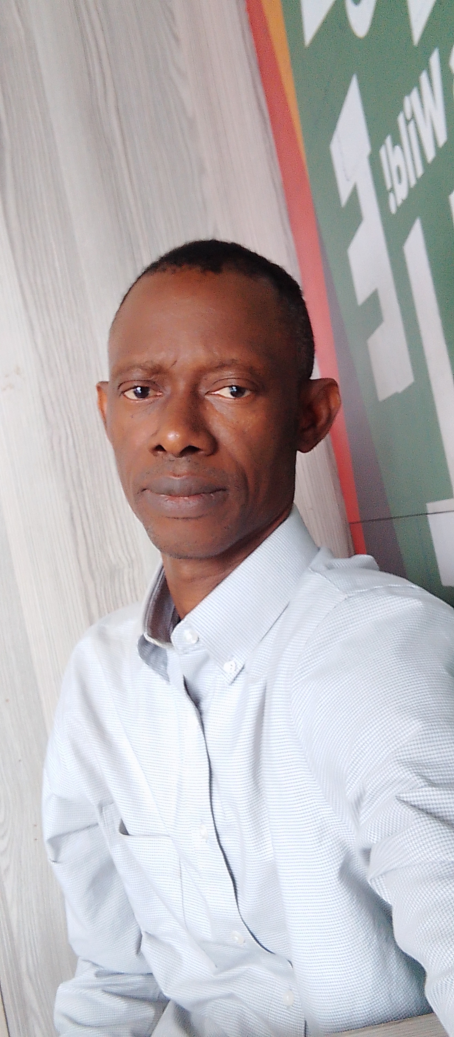
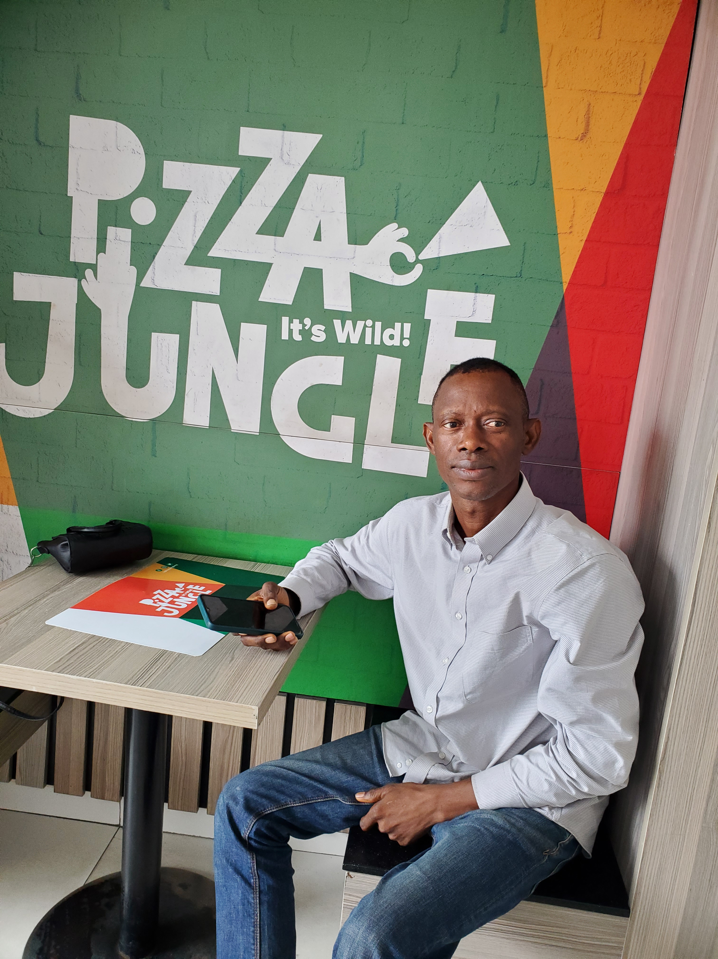
Entrepreneur & Team
CEO CFO SALES DIRECTOR
AJAYI OLANIYI JOSEPH POPOOLA REBECCA OLAMIDE

Slide 13
Outcomes
(Impact & Scale)
Metrics and Data Points:
Customer Engagement:
Website traffic: 5,000+ unique visitors
Social media engagement: 500+ interactions (likes, comments, shares)
Product Performance:
Solar panel efficiency: 20% increase (compared to industry average)
Battery life cycle: 500+ cycles (exceeding industry standards)
Financial Projections:
Projected revenue (2024): $200,000
Projected growth rate (2025-2027): 20% YoY

Slide 14
Ask
Categorizing the Solar Panel Power Bank Business .
Category 1: Solar-Powered Charging Café Category 2: Solar Panel Power Bank Manufacturing and Distribution
Business Model: Charging station for laptops, phones, and electronics Business Model: Partnering with manufacturers, buying in bulk.
Revenue Streams: Revenue Streams:
Charging fees (e.g., $1/minute) Wholesale and retail sales
Food and beverage sales Distribution partnerships
Advertising Initial Investment:
Initial Investment: Partnership establishment: $50,000 - $200,000
Solar panel power bank systems: $10,000 - $50,000 Initial inventory purchase: $100,000 - $500,000
Cafe setup (furniture, equipment): $20,000 - $100,000 Marketing and advertising: $20,000 - $100,000
Marketing and advertising: $5,000 - $20,000 Total: $670,000 - $2,800,000
Total: $35,000 - $170,000 Ongoing Expenses:
Ongoing Expenses: Inventory management
Staffing Staffing and logistics
Maintenance and replacement of solar panels
Marketing and advertising
Ongoing Expenses: Manufacturing Plant Setup (Optional)
- Inventory management Land acquisition: $100,000 - $500,000
- Inventory management Building construction: $500,000 - $2,000,000
- Staffing and logistics Equipment and machinery: $500,000 - $2,000,000 Staffing and training: $100,000 - $500,000
Total: $1,200,000 - $5,000,000

Slide 15
THANK YOU
Notes:
Clear and Concise Not Wordy
Colourful/ Catchy
Use of graphs, chats and related imagery
Map out a process if it is complicated

Slide 16


